Slide 1
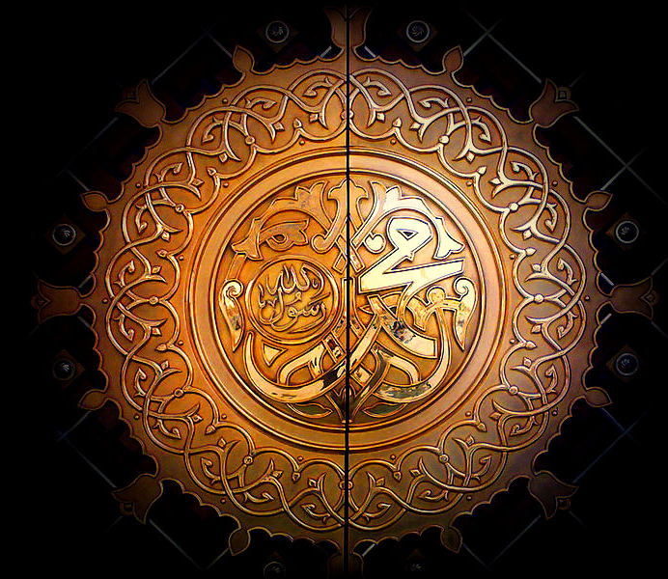
Life of Muhammad

Slide 2
Key Events
c. 570 – Birth of Prophet Muhammad
610 – Muhammad receives first Revelation at Mt. Hira
613 – Muhammad begins to proclaim Islam publicly
619 – Death of Khadija (Muhammad’s wife) and Abu Talib (Muhammad’s uncle and protector)
622 – The Hijra – emigration to Yathrib
630 – Muhammad victory over Quraysh & Muslim occupation of Makkah
632 – Last Sermon & Death of Muhammad

Slide 3
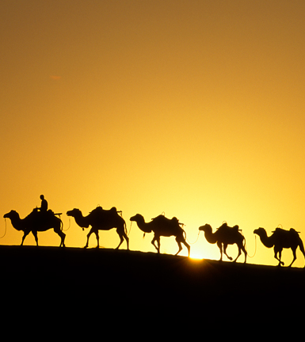
Muhammad early life
Looked after by Bedouin woman (foster-mother)
Orphaned at age 6
Goes to live with his uncle aged 8
Many stories tell of signs of prophethood from early on
Bahira – Christian monk, recognises Muhammad as future prophet
Worked for uncle as a trader
Khadija, 40 y/o widow, hires Muhammad for his honesty & integrity
Eventually proposes marriage to 25 y/o Muhammad
Happy marriage – 6 children

Slide 4
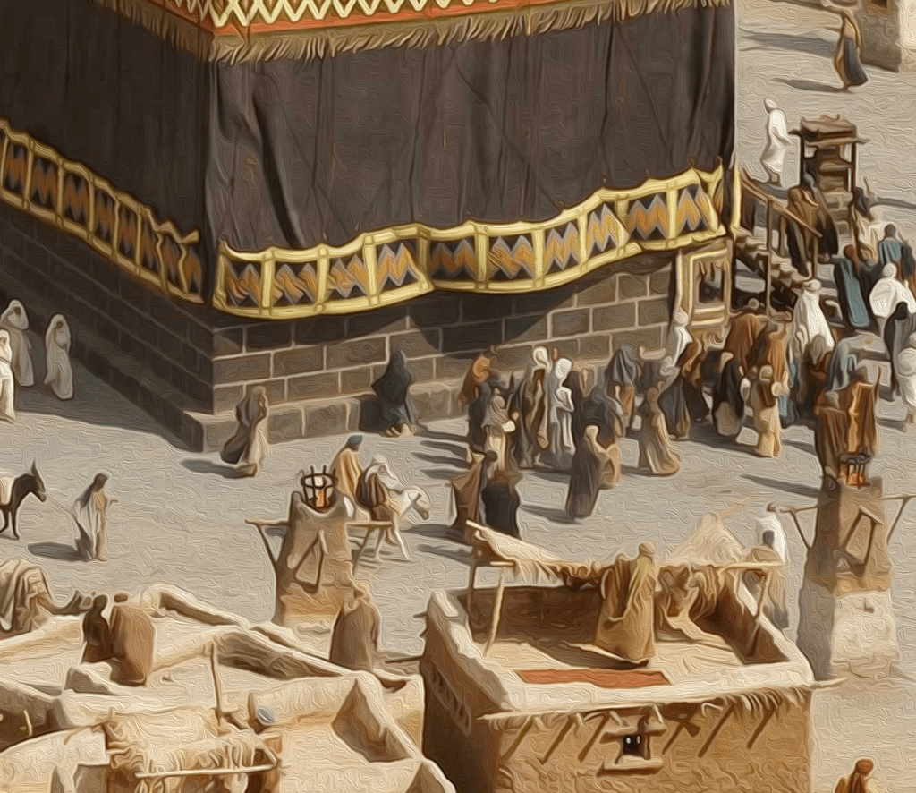
Makkah (Mecca)
Religious city of numerous religions
Ka’ba housed many idols
Important pilgrimage site

Slide 5
The Night of Power
Muhammad often spent time alone meditating
Each year, during the month of Ramadan, he went alone to a cave called Hira outside the city
When he was 40, his fifth year at the cave, he had a surprise visitor from an angel
“Read!” the voice commanded.
What shall I read?” Muhammad gasped.
The invisible presence tightened its embrace. “Read!”
“What shall I read?” Muhammad asked again, his chest caving in.
Once more the presence tightened its grip and once more the voice repeated its command. Finally, at the moment when he thought he could bear no more, the pressure in his chest stopped, and in the silence that engulfed the cave, Muhammad felt these words stamped upon his heart:
Read in the name of your Lord who created,
Created man from a clot of blood.
Read, for your Lord is the Most Generous One
Who has taught by the pen;
Taught man that which it did not know.

Slide 6
Revelation
This was the start of the revelations of the Qur’an
Muhammad very scared by visit
Khadija comforts him and her Christian cousin assures him he is a prophet
Khadija accepts his message and later devises a test to check whether Gabriel a good or demonic spirit
Muhammad began to preach his message publicly
Told people not to worship idols, and to change their behaviour
Angered many of the people of Mecca (specifically the Quraysh who controlled access to the Mecca)

Slide 7
619 onwards
Muhammad initially protected from abuse by his uncle Abu Talib
He was the leader of Muhammad’s clan and very powerful
In 619, both Muhammad’s wife & uncle died
After the death of Abu Talib, Muhammad lost his protection
People began to openly abuse him and assault him
Luckily, a few years later pilgrims from the nearby city of Yathrib invited Muhammad to come and live with them over 300km away

Slide 8
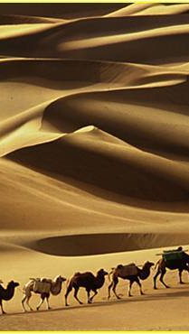
Hijrah
Muhammad sends followers ahead of him
He himself is last to leave with Abu Bakr (close friend) and Ali (cousin)
Ali tricks Quraysh
This journey is known as the Hijrah
So important that the Muslim calendar starts from this year 622 (1AH – after Hijrah)

Slide 9
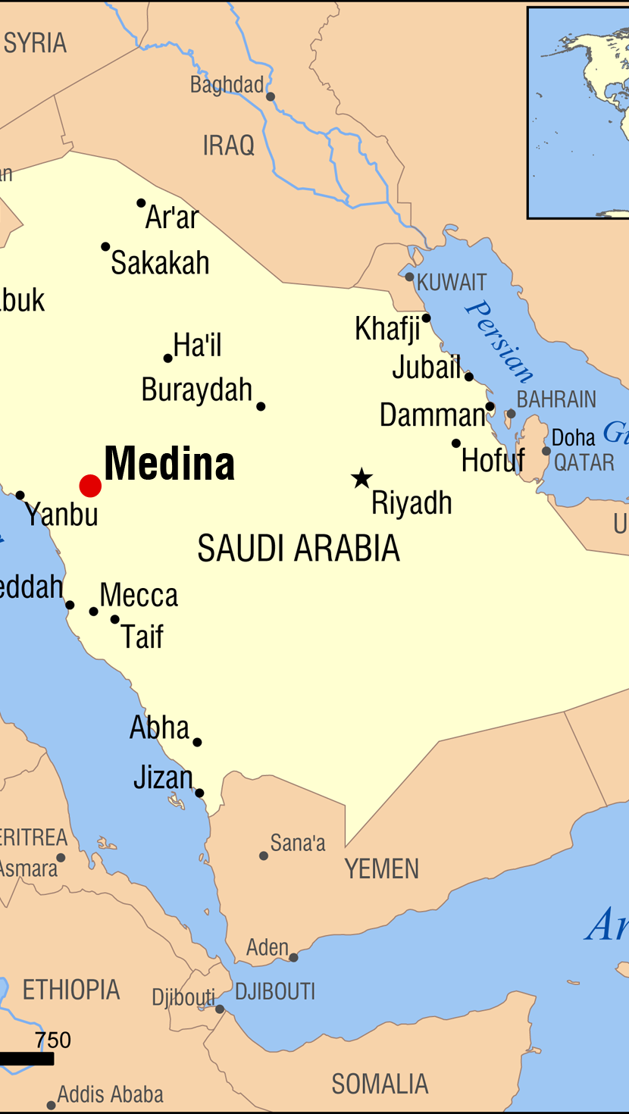
Madinah (Medina)
In Yathrib, Muhammad started the first Muslim community
The city was later renamed ‘Madinah-al-Nabi’ (the City of the Prophet)
The first mosque was built there and Muhammad’s house was next door
Muhammad taught that everyone was equal in the eyes of God
He mended his own clothes, and did his own shopping
Muhammad became Madinah’s spiritual and political leader
Over the next few years, Makkah and Madinah would engage in a series of battles as those from Makkah still hated Muhammad

Slide 10
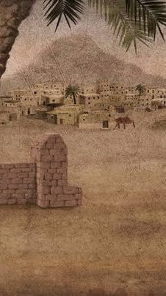
Muhammad’s last years
In 630, Muhammad and his followers returned to Makkah
Muhammad became the new leader of Makkah and set up the Ka’ba as the centre for the worship of Allah
Continued to receive the revelation of the Qur’an until his death
In 632, Muhammad makes final pilgrimage to Mecca
While in Mecca, delivered his final sermon urging unity amongst Muslims
Tells pilgrims he had left them two things: Sunni believe them to be Qur’an and his example; Shi’a believe them to be Qur’an and his family (Ali – successor)

Slide 11
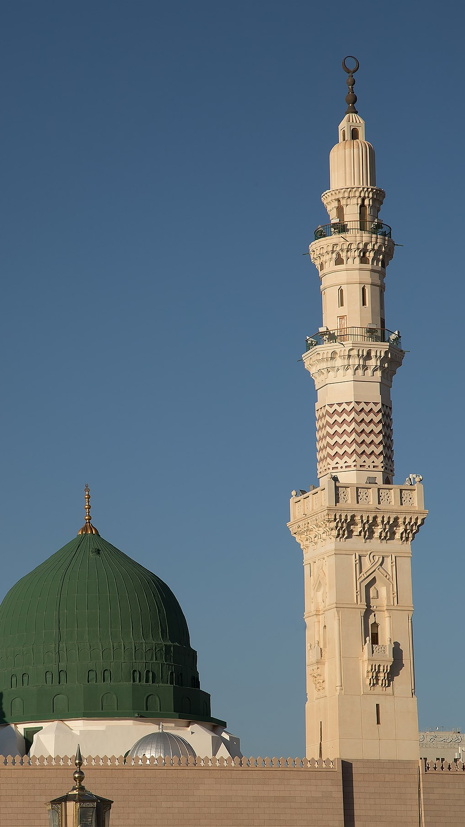
Muhammad’s last years
In the same year, Muhammad fell ill
He knew he was close to death so returned to Madinah where he died in the arms of his wife Aisha
His tomb is today in Madinah
Islam holds that Muhammad was the last of the prophets sent by God and as such is known as the Seal of the Prophets
Muhammad is not a father of any of your men, but he is a messenger of Allah and the last of the prophets. And Allah has the Knowledge of every thing (Quran 33:40)

